Slide 2
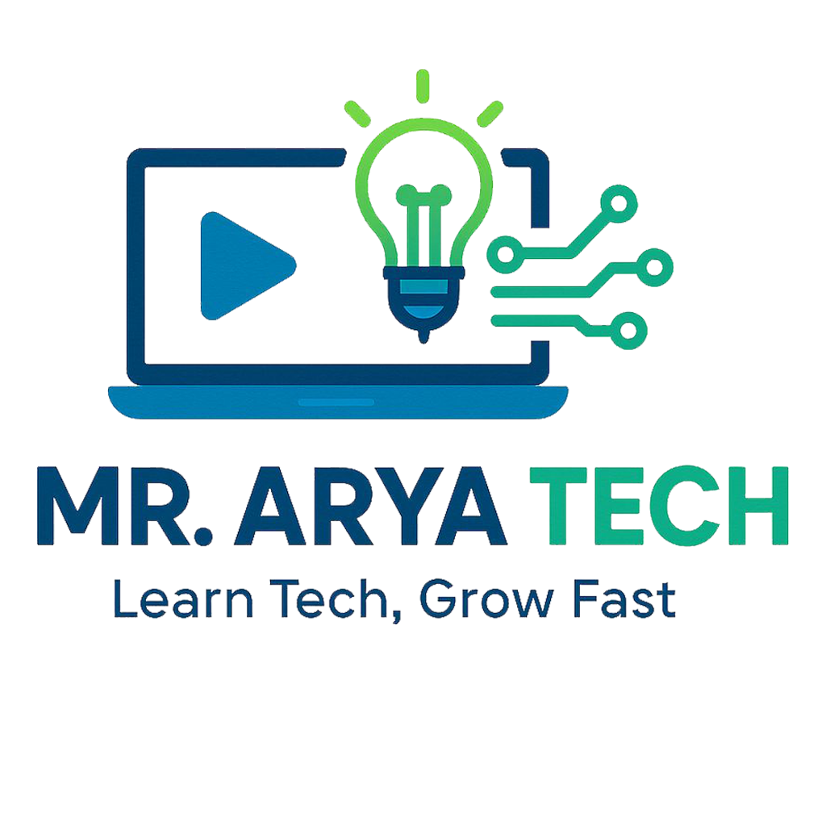
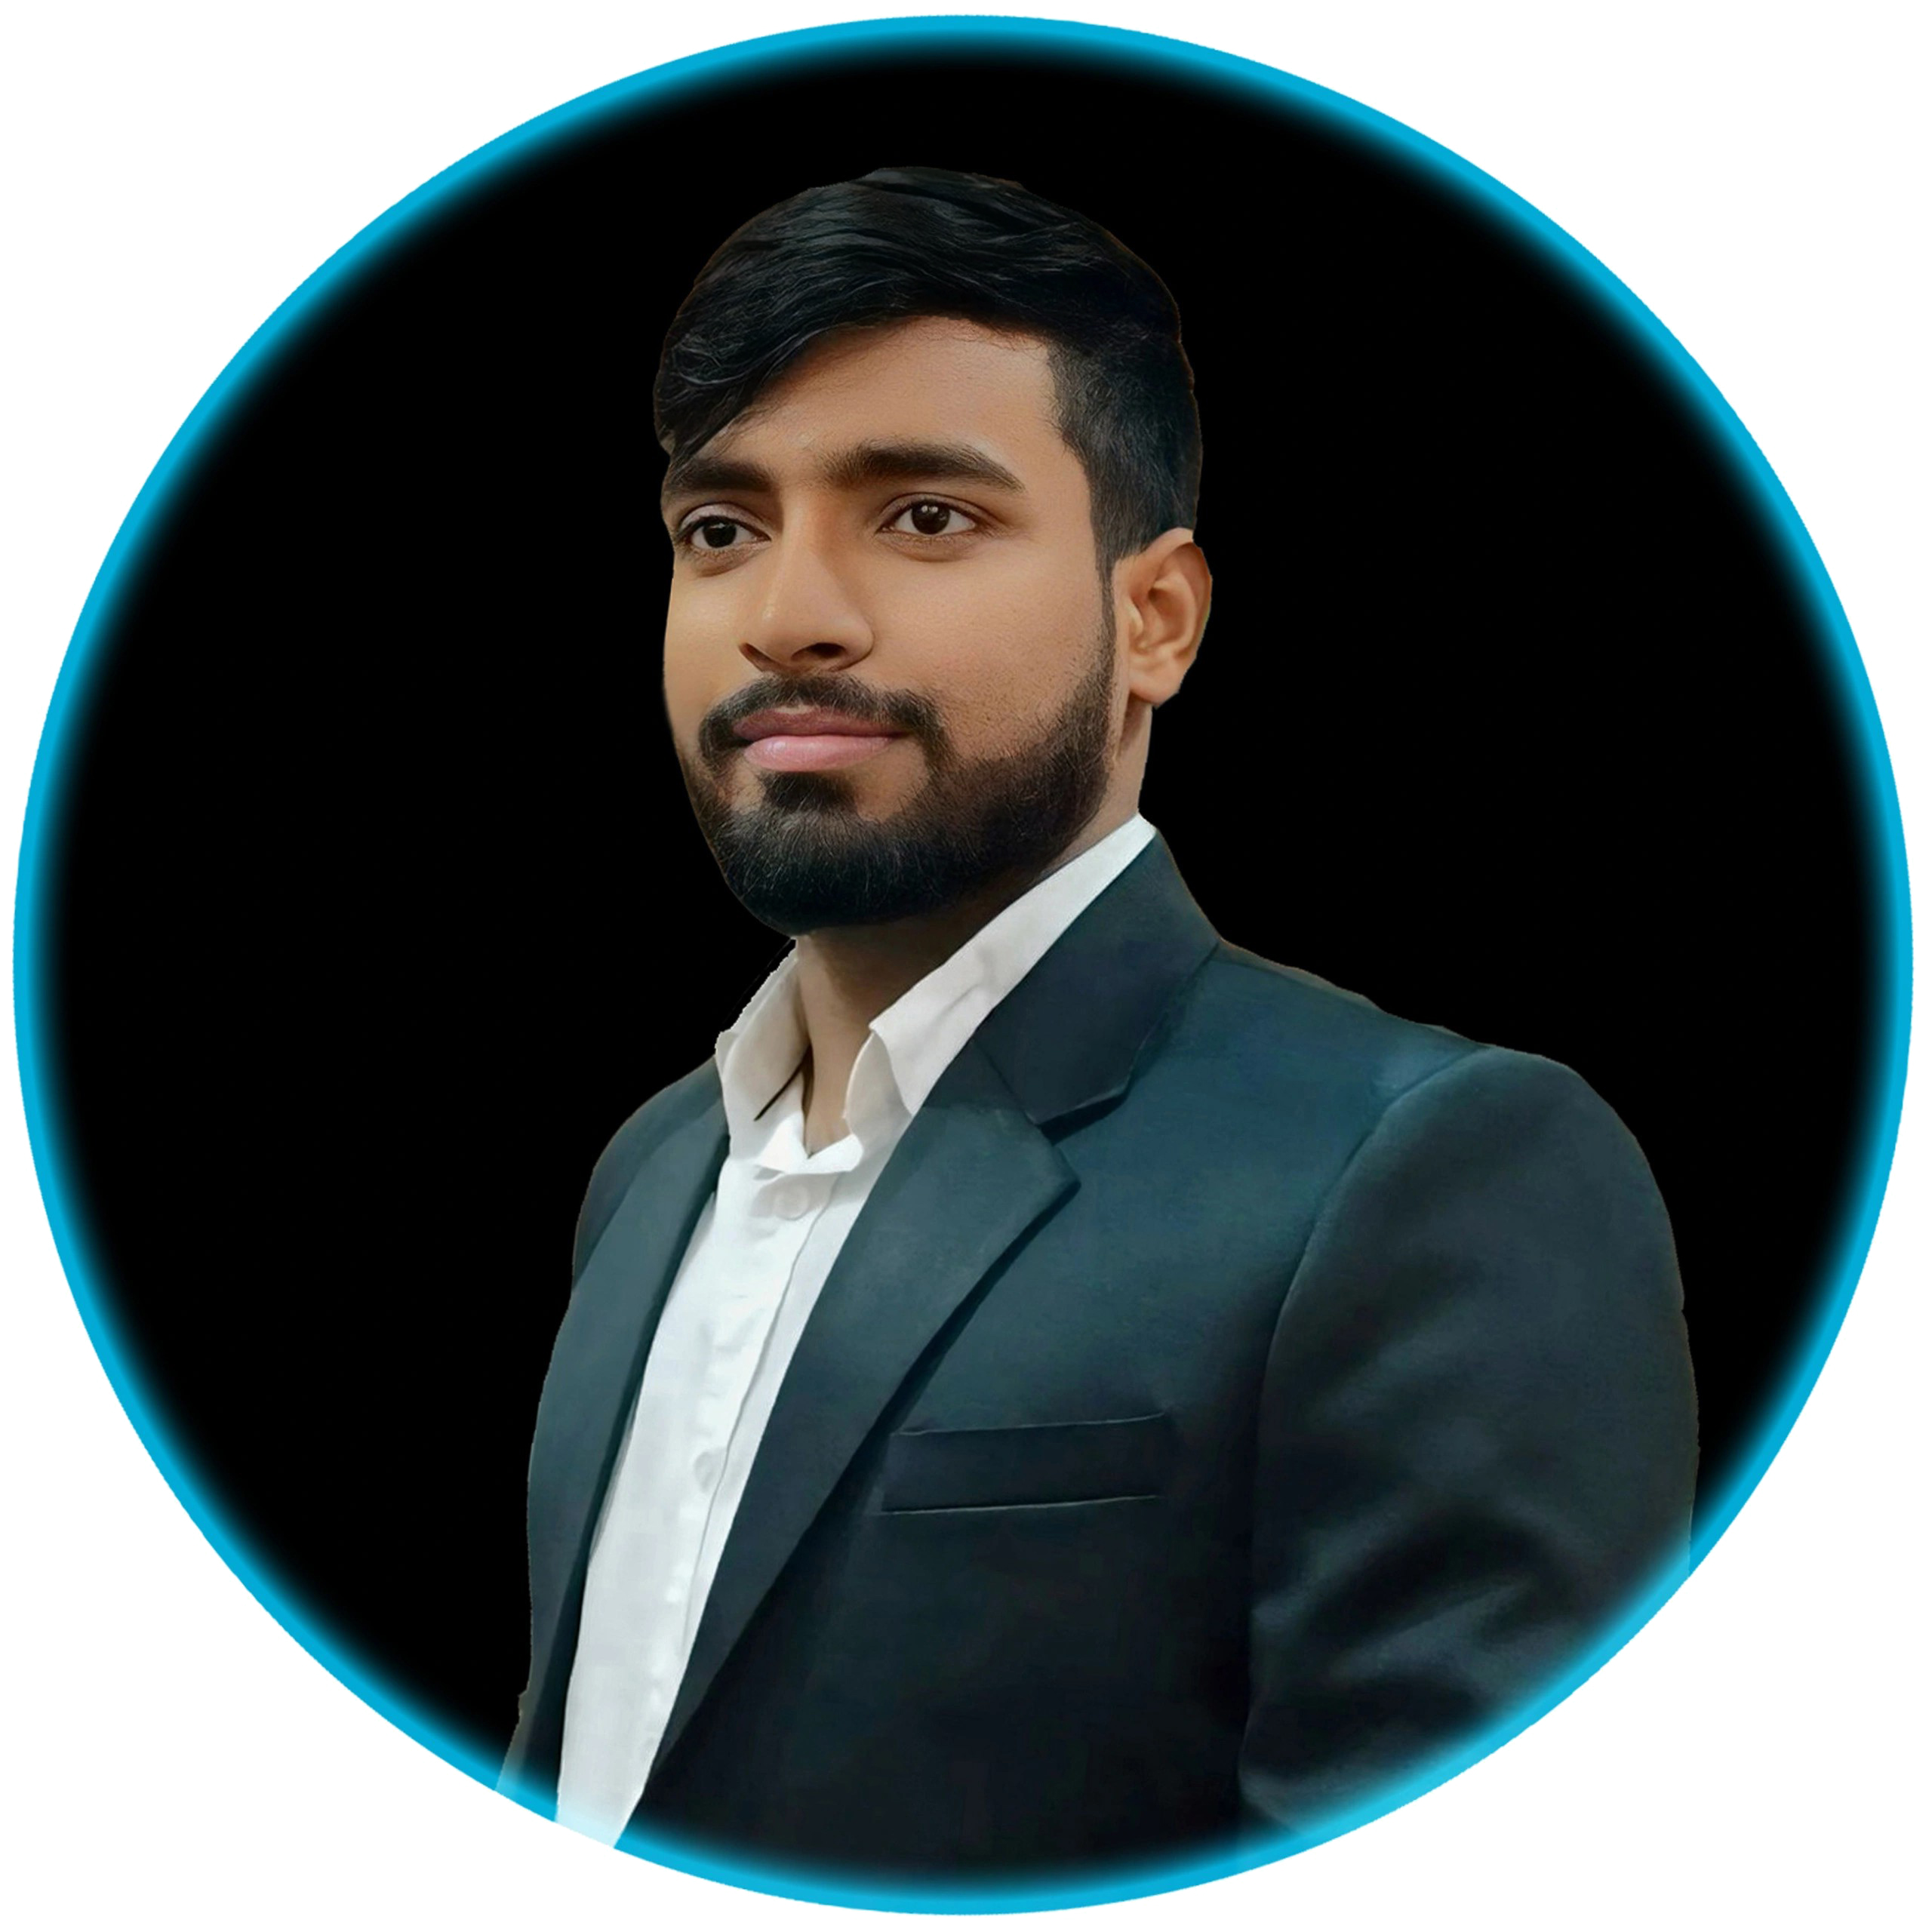

Digital Empowerment for Students
Safe, Smart & Future-Ready
Presented by: Suraj Arya
14 September 2025 | 9 AM – 11 AM
Notes:
Hello Everone! Suraj Arya, aapka swagat karta hoon is free workshop mein. Aaj hum seekhenge kaise technology ka use safe aur smart tareeke se use kar sakte hain,
taaki hum apne studies aur daily life mein better perform kar sakein.

Slide 3

Workshop Overview
Digital literacy essentials
Cyber security tips
AI tools for productivity
Smart tech habits for everyday life
Interactive Q&A session
Notes:
Aaj hum 4 important topics cover karenge
digital literacy, cyber security, AI tools, aur smart technology habits.
Aapko practical tips milenge jo aap apne studies mein turant use kar sakte hain.

Slide 4
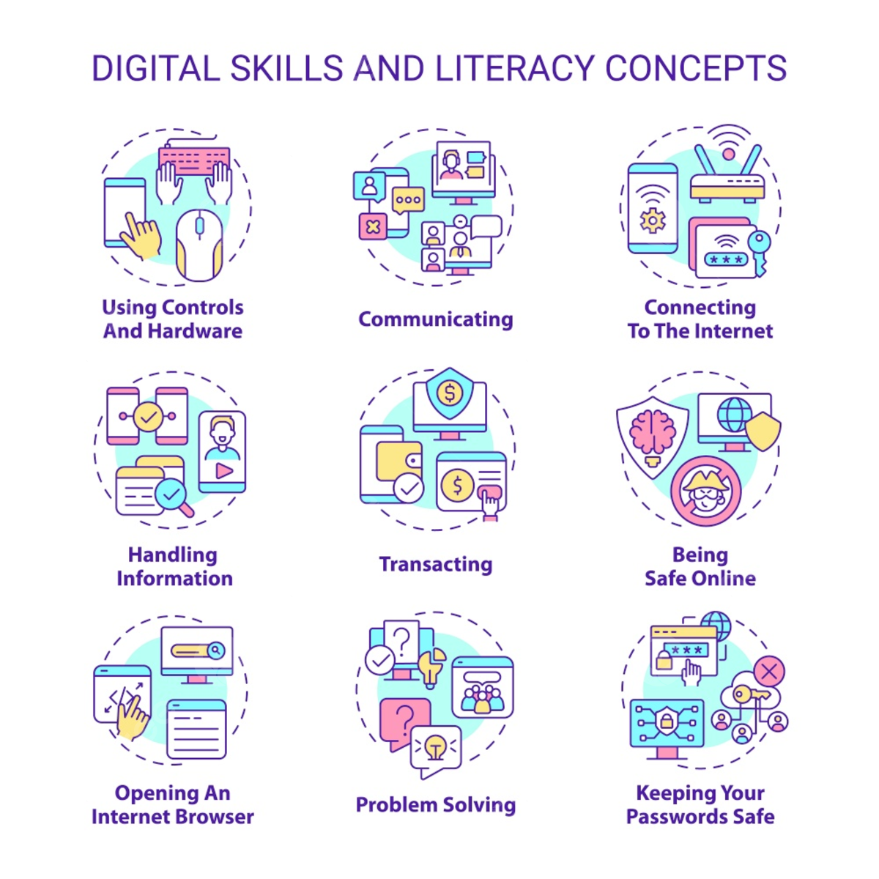
Digital Literacy for Students
Using devices confidently
Cloud storage & note-taking tools
Educational websites & apps
Online research tips
Notes:
Digital literacy ka matlab hai technology ko smart tareeke se use karna.
Hum dekhenge kaunse apps aur websites aapko notes banane, research karne aur assignments complete karne mein help karenge.

Slide 5

Practical Study Tools
Google Docs & Sheets for notes and assignments
Google Keep for reminders
YouTube educational channels
Online libraries & research tools
Notes:
Google Docs aur Google Sheets se aap notes aur assignments organize kar sakte ho. Google Keep se reminders set kar sakte ho. YouTube aur online libraries se study material easily mil jayega.

Slide 6

Cyber Security Basics
Strong passwords
Two-factor authentication
Recognizing scams & phishing emails
Safe browsing habits
Browser (Firefox, Brave)
Updated Software Use
Account Private
Notes:
Online safe rehna bahut zaruri hai. Strong password use karo, 2-step verification lagao, phishing emails aur fake links se bachke raho. Aaj main aapko practical tips dunga jo aap turant apply kar sakte ho.

Slide 7
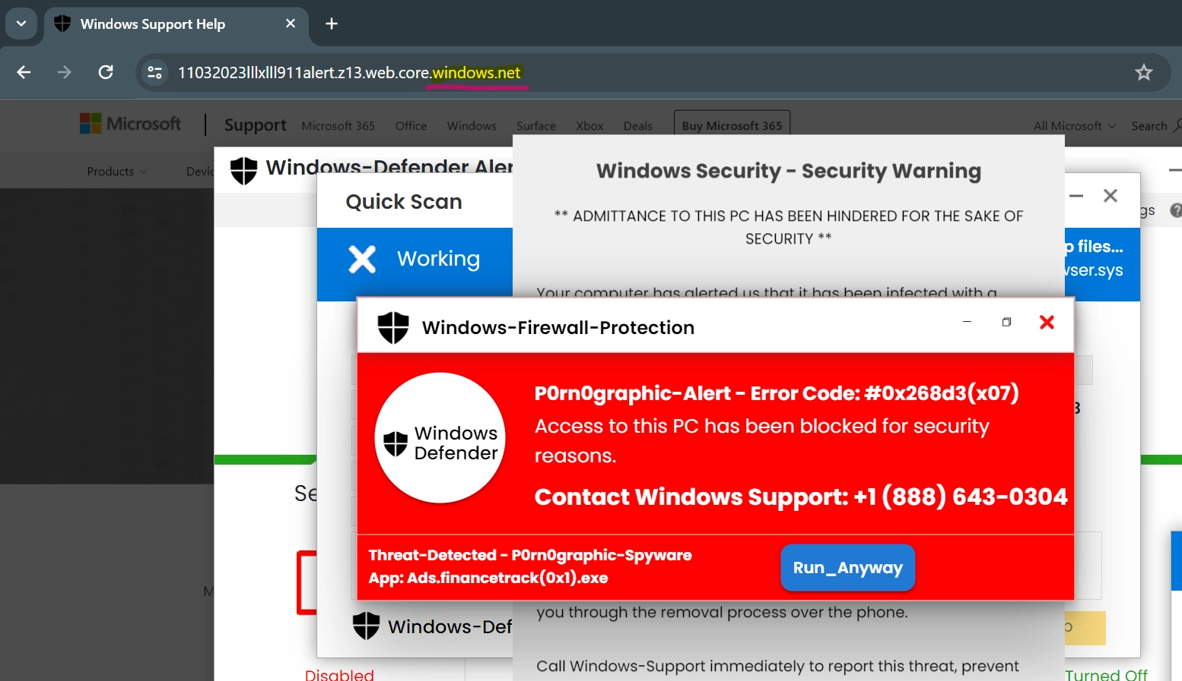
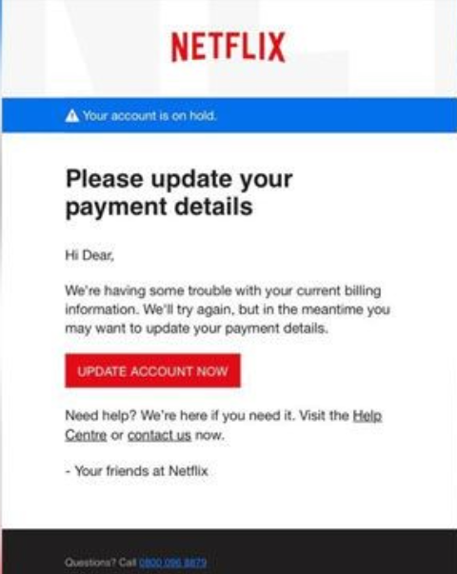
Spotting Scams
Fake links
Unverified websites
Social media traps
Notes:
Bahut log fake websites aur emails mein fas jaate hain. Aaj main kuch examples dikhaunga, jisse aap samajh paoge ki kaise scam ka pata lagana hai aur apne data ko secure rakhna hai.

Slide 8
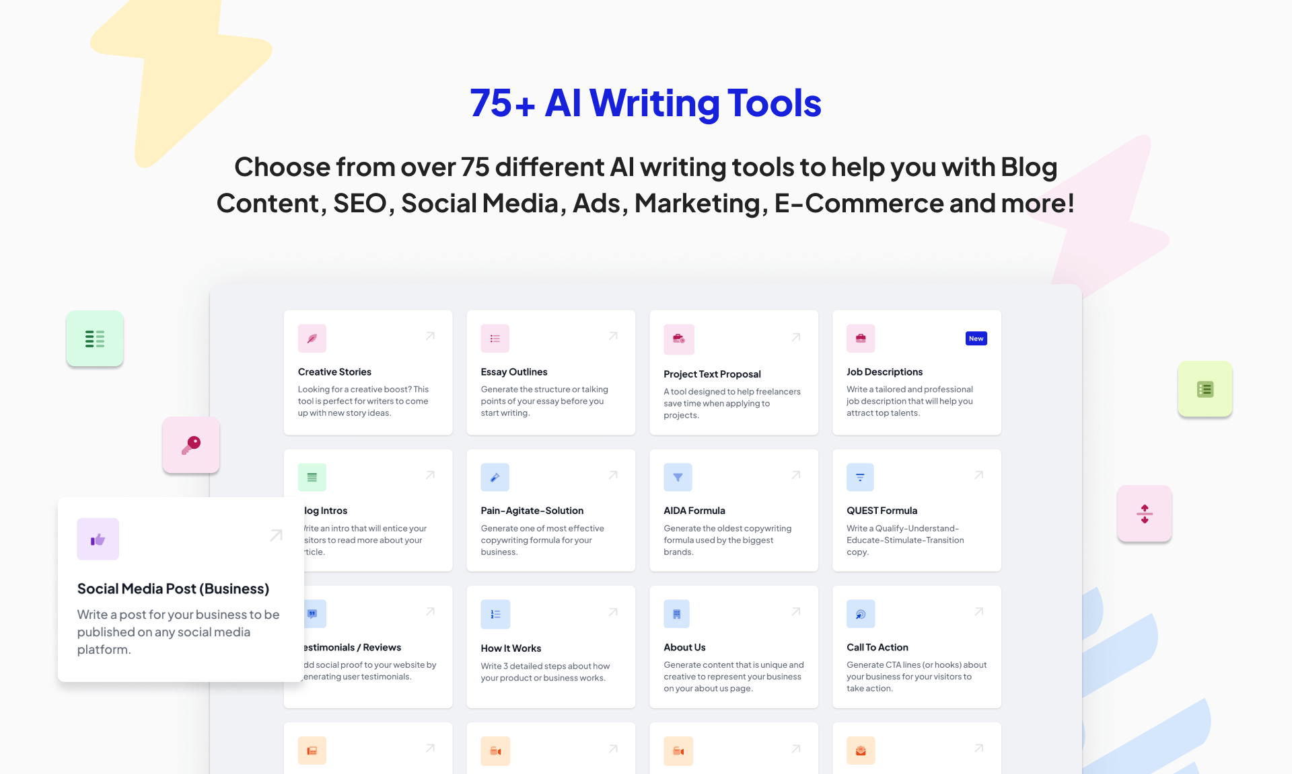
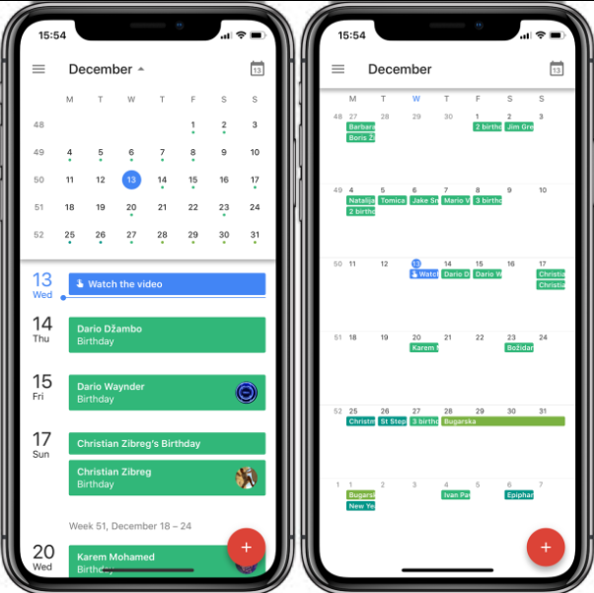
AI Tools for Everyday Work
Grammar checkers & writing assistants (ChatGPT)
Image editing tools (Canva)
Scheduling and reminders (Google Calendar)
Learning platforms with AI support
Notes:
AI tools se aap apna kaam fast aur smart tareeke se kar sakte ho. Jaise grammar check karna, image edit karna, schedule banana ya task organize karna. Hum kuch tools explore karenge jo free aur useful hain.

Slide 9

Ethical Use of AI
Verify information
Avoid over-reliance
Understand AI limitations
Balance with manual learning
Notes:
AI helpful hai, lekin hume iska misuse nahi karna chahiye. Har cheez AI par depend mat ho, fact check karo aur apne dimaag ka use karo. Balance banana zaruri hai.

Slide 10

Smart Tech Habits
Time management apps (Digital Wellbeing)
Avoid distractions
Set screen limits
Create learning schedules
Notes:
Technology distractions bhi create karti hai. Isliye apps use karke apna time manage karo. Screen time limit karo aur focus banaye rakho. Smart tareeke se technology use karne se productivity double ho sakti hai.

Slide 11
Recommended Apps
Google Calendar – reminders & schedules
Grammarly – writing enhancement
ChatGPT - AI Assistant
Brave, Firefox
Digital Wellbeing
Notes:
Forest app se focus maintain karo, Trello ya Notion se apne tasks plan karo, Google Calendar se reminders set karo aur Grammarly se writing improve karo. Ye tools daily life mein kaafi helpful hain.

Slide 12


Q&A & Wrap-Up
Ask your questions!
Explore more tools
Stay connected
Notes:
Agar aapko koi doubt hai ya aap kisi tool ke baare mein aur jaana chahte hain to ab aap questions pooch sakte hain. Hum milke solutions find karenge aur aapko best tools suggest karenge.

Slide 13

Stay Connected
YouTube: Mr.AryaTech
Facebook: OfficialSurajArya
Instagram: OfficialSurajArya
Contact: 8427714353
Thank You
Notes:
Mujhe follow karna na bhoolen! YouTube, Facebook aur Instagram pe aapko aur bhi helpful videos milengi. Agar aapko kisi help ki zarurat ho to contact bhi kar sakte hain. Hum saath milke tech seekhenge!

